Slide 1

Helping Your Child with Maths at KS2

Slide 2
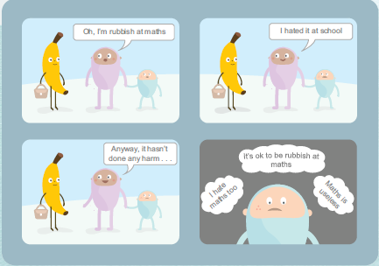
Attitudes to Maths
With a little confidence
and some “have-a-go
attitude” parents can
make a big difference.

Slide 3

The Curriculum
Expectations
By the end of year 4 pupils should
memorise their multiplication tables up to and including the 12 times table
show precision and fluency in their work
By the end of year 6 pupils should
- Be fluent in written methods for all four operations, including long multiplication and division, and in working with fractions, decimals and percentages.
-Pupils should read, spell and pronounce mathematical vocabulary correctly.

Slide 4
Number Sense
is what we’re aiming for
Number sense is an intuitive understanding of numbers, their size, relationships,
and how they are affected by operations such as adding, multiplication and division.
It’s a kind of “maths fluency” which involves applying mental
arithmetic accurately and quickly but also knowing before hand
what answer to expect.
If a child can achieve number sense they’ll have the perfect
foundation for future challenges in maths and related subjects.

Slide 5
Mental Maths
Every class has a 20 minutes daily mental maths session.
Mental Mathematic Strategies:
Use number bonds to 10, 20 and 100 transferable to 1,000 and decimals
Multiplication and division by 10, 100, 1,000, 0.1
Use doubles and near doubles
Partition into thousands, hundreds, tens and units
Adding near multiples of 10. Adding the multiple then add or subtract 1
Subtracting near multiples of 10. Subtracting the multiple then subtracting or adding 1.
These are transferable to multiples of 100, 1,000 etc.
-Using known table facts e.g. 3x8 = 24 then 0.3 x 8 = 2.4

Slide 6
The 4 Operations
Calculation Methods and Progression

Slide 7
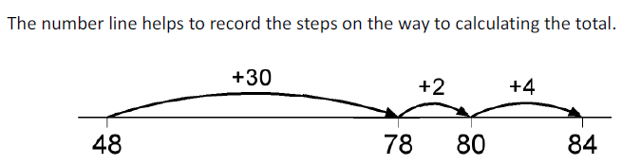
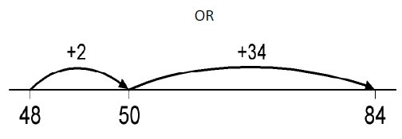
Addition Lower Key Stage 2
Number Lines:
48 + 36 =

Slide 8
Addition
Addition – Lower KS2
Partitioning:
Partitioning means splitting the number into the tens and units.
48 + 36 = 40 + 30 = 70 40 + 8
8 + 6 = 14 30 + 6
= 84 70 + 14 = 84

Slide 9
Addition
Addition – Lower KS2
Expanded methods in columns:
Children’s understanding of place value has to be secure.
48 + 36 = 84
4 8
3 6 +
1 4 – adding units first
7 0 – adding tens
8 4

Slide 10
Addition
Addition – Upper KS2
Column Method:
This method remains efficient when adding larger numbers and decimals. It is a quick and reliable method.
48 + 36 = 84
4 8
31 6 + carrying ‘ten’
8 4

Slide 11
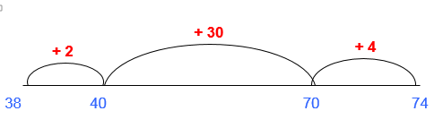
Subtraction
Subtraction – Lower KS2
Counting On ‘Finding the difference’
Count on from the smallest to the largest once again bridging through ten or a multiple of ten.
74 – 38 = (2 + 30 + 4) = 36

Slide 12
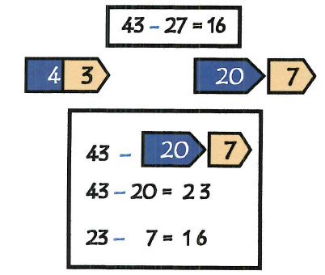
Subtraction
Subtraction – Lower KS2
Partitioning:

Slide 13
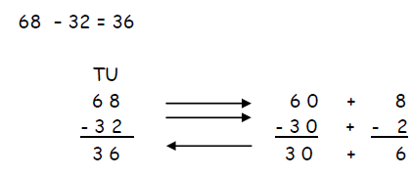
Subtraction – Lower KS2
Partitioning:

Slide 14
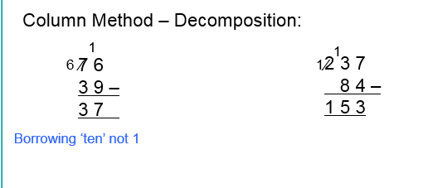
Subtraction – Lower & Upper KS2

Slide 15
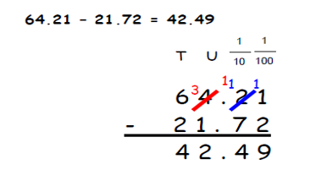
Subtraction –Upper KS2

Slide 16
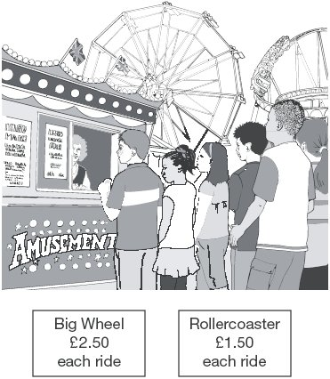
Word Problems
Liam spends £14 altogether on the Big Wheel and the Rollercoaster.
He goes on the Big Wheel twice.
How many times does he go on the Rollercoaster?

Slide 17
Word Problems
Dev and Joe each buy a book.
Dev pays with a £5 note and gets £1.05 change.
Joe’s book costs £7
How much more does Joe’s book cost than Dev’s book?

Slide 18
Multiplication – Lower KS2
Grid Method:
43 X 6
124 X 32
X | 6
4 0 | 2 4 0
3 | 1 8
 | 2 5 8
X | 3 0 | 2
1 0 0 | 3 0 0 0 | 2 0 0 | 3 2 0 0
2 0 | 6 0 0 | 4 0 | 6 4 0
4 | 1 5 0 | 8 | 1 5 8
 |  |  | 3 9 9 8

Slide 19
Multiplication – (Lower) & Upper KS2
Short Multiplication:
4 3 X 6
4 3
6 x
2 5 8
1

Slide 20
Multiplication – Upper KS2
Long Multiplication for 2-digit x 2 digit:
5 6 x 2 7 =
5 6
2 7 x
39 2
1 1 2 0 +
1 5 1 2
When multiplying by the ten (20 in this example) children must remember to put the place holder ‘0’ in the units column.
4
1

Slide 21
Division – Lower KS2
Grouping using multiplication knowledge:
This method uses children’s understanding on times tables and links to their mental calculations.
e.g. 43 ÷ 7 =
I know 6 X 7 = 42 so …
43 ÷ 7 = 6 remainder 1

Slide 22
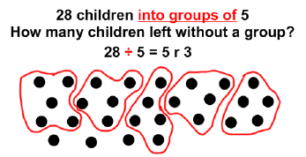
Division – Lower KS2
Grouping using jottings

Slide 23
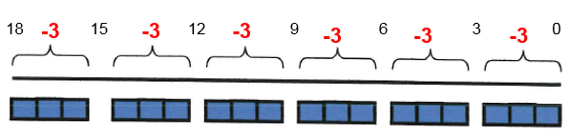
Division – Lower KS2
Division as repeated subtraction 18 ÷ 3 = 6

Slide 24
Division – (Lower) & Upper KS2
Expanded Method – Chunking:
87 ÷ 6 =
6 8 7
6 0 - 6 x 10
2 7
2 4 - 6 x 4
3
Answer = 14 r 3

Slide 25
Division – (Lower KS2) & Upper KS2
Short Division - TU ÷ U:
81 ÷ 3 =
2 7
3 8 1
Answer = 27
2

Slide 26
Division – Upper KS2 (Year 6)
560 ÷ 24 =
23
24
560
48
8
0
72
Answer = 23 r 8
8

Slide 27
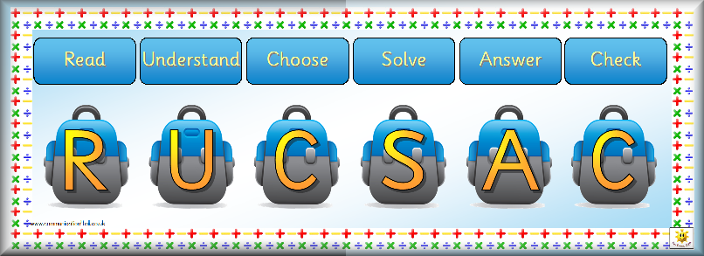
Problem Solving
Using and applying knowledge and skills

Slide 28
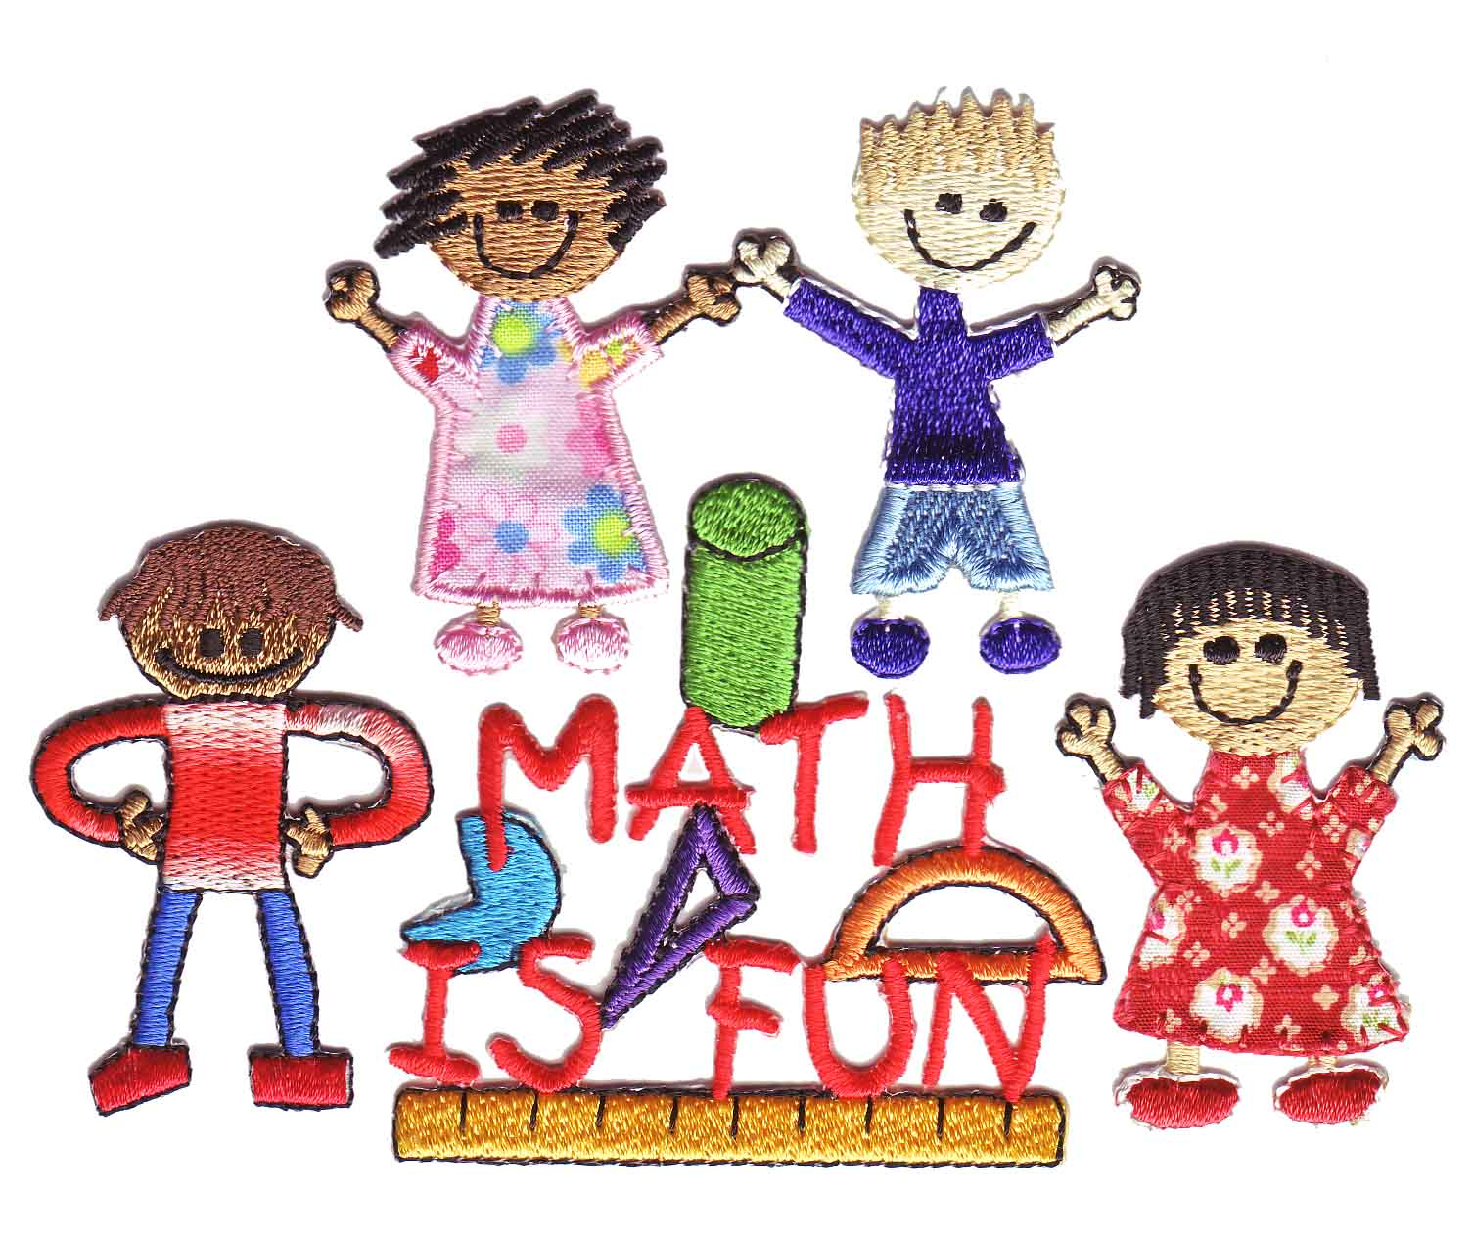
Helping your child with maths
Try to make maths as much fun as possible - games, puzzles and jigsaws are a great way to start. It's also important to show how we use maths skills in our everyday lives and to involve your child in this.
Identifying problems and solving them can also help your child develop maths skills. If you see him or her puzzling over something, talk about the problem and try to work out the solution together.
Don't shy away from maths if you didn’t like it at school. Try to find new ways to enjoy the subject with your child.
Tips for helping your child to enjoy maths:
Point out the different shapes to be found around your home.
Take your child shopping and talk about the quantities of anything you buy.
Let your child handle money and work out how much things cost.
Look together for numbers on street signs and car registration plates.
Homework
Tables

