Slide 1




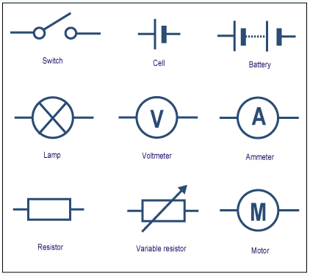
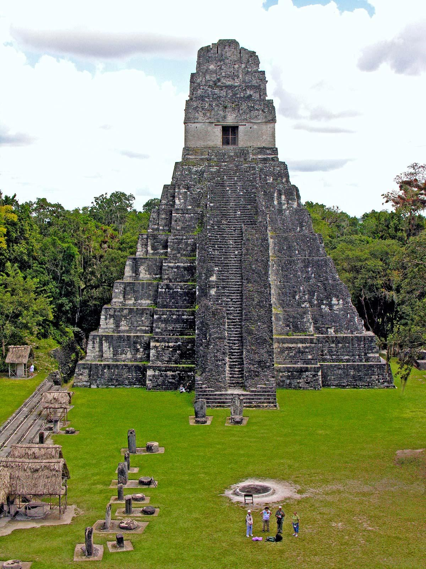
Year 6 Newsletter
Targets
Reading
To give thorough explanations of points
and prepare responses to likely conflicting opinions.
Speaking and Listening
To participate in discussions, presentations, performances, role play, improvisations and debates
Maths
To develop a further understanding of algebra
Personal
To develop independence and organisation
Summer Term 2
Welcome back Year 6, we are in your final half term of Primary School. There is a lot going on this half term, including getting your leavers hoodies which I know you are excited about! This half term term you still have PE on a Monday and Wednesday afternoons. Please bring in your full PE kit on PE days.
English
We are going to start the term by finishing our Alma Ghost Stories. After this we will move on to writing playscripts and editing some earlier pieces of writing.
Science
Last half term, our Science focus was the circulatory system. This half term we will be switching to electricity. We will be making lots of circuits and
understanding the various symbols
involved in circuit diagrams whilst also
determining how the voltage of cells
affects the brightness of a bulb!
Home learning
- Spellings will be given out
every Friday, for a test the
following Friday.
- In addition to spellings and
reading, a History, Science or
Geography activity will be given
out on a Friday and will be due in
the following Friday - on Seesaw
and printed if need be.
- Parents/carers,
Reading Diaries should
continue to be brought in to
school every day. Reading at
home and reading diaries signed
by an adult will lead to house
points!
- Times Tables Rockstars
and Maths Shed
Please try to encourage your
child to access TTRS regularly.
On Maths Shed they can
practise their maths skills in a
variety of challenges (Ed Shed
login).
History (Continued)
Our History focus is the Maya Civilisation! In this unit, we will look at the context of this civilisation in a world setting, find out when the Maya are first recognised by archaeologists and when this society is said to have come to an end. The Maya created writing using logograms and hieroglyphs and Year 6 will be finding out how the writing was used to help them write and draw words and their names.
Key dates in Year 6 Summer Term
2nd June – Training Day
4th June – Cricket Tournament at Backworth Cricket Club
17th June – Sports Day
3rd July – Alnwick Gardens
7/8th July – NGA Transition Days (make your own way)
16th July – Leaver’s Assembly
Parents/carers, if you have any queries, please email school or ring to arrange a call back. Thank you.
Mrs Jones

