Slide 1




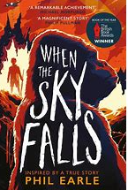
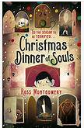

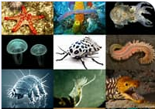
Year 5/6 Newsletter
Targets
Reading – To summarise
main ideas, identifying key details and using quotations in verbal and written responses.
Writing – To use grammatical structures and features and choose vocabulary appropriate to the audience, purpose to make meaning clear and create effect.
Maths - to develop strategies to increase efficiency when calculating mentally and develop resilience when using multiplication and division to problem solve.
Autumn Term 2
Years 5/6
What a fantastic start to the year during our first half-term! We have already seen a huge improvement in your independence, organisation and concentration. It has been great to see so many of you taking on new roles and responsibilities. This half-term we will looking out for kindness and good manners in the classroom and around school.
English
We are going to continue to read our wonderful class novel: When the Sky Falls. Listening to our novel is such a lovely time of the day as will continue
to enjoy this. Towards Christmas
we will introduce you to a fantastic
book by Ross Montgomery.
Remember to keep exploring new
authors and genres. We will be writing
a non-chronological report, a
biography and some poetry based on war.
Geography
Our geography focus will be Britain’s National Parks. This links well to our High Borrans visit in the Spring term. We will be locating them and finding out why they are special before comparing them to urban landscapes.
We will think in depth about who
Britain’s National Parks are for.
Home learning
- Spellings will be given out every
Friday, for a test the following
Friday.
In addition to spellings and
reading, a Maths and English
activity will be set on Learning
Questions (Y6) and set on paper
(Y5). This will be given out on a
Friday and will be due in the
following Friday. All homework
must be completed. If you
encounter any problems, please
ask for help towards the
beginning of the week.
- Parents/carers,
Reading Diaries should
continue to be brought into
school every day and the children
should be reading regularly.
- Times Tables Rockstars
Please try to encourage your
child to access TTRS regularly.
Children MUST be able to recall
multiplication and division facts
with speed and accuracy in order
to access the Y5/6 maths
curriculum. Please help us to
support your child with this.
Science
This half term in science, we will be learning
about living things and their habitats. This will
include: classifying animals, plants and
microorganisms based on their characteristics,
similarities and differences.
Other information
Please remember that there is lots of important information on our website:
burradoncommunityprimaryschool.co.uk
Parents/carers, if you have any queries please email school or ring to arrange a call back. Thank you.
Mrs Jones

