Slide 1
Welcome to parents/carers PSHCE including Relationhips and Sex Education overview
Summer Term 2026

Slide 2
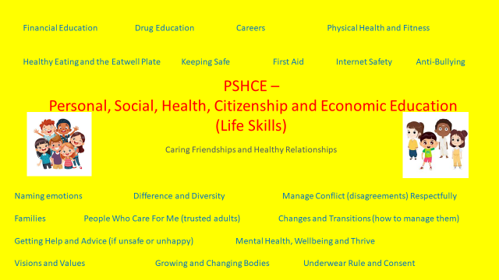

Slide 3
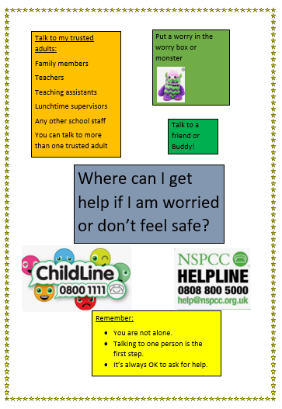

Slide 4



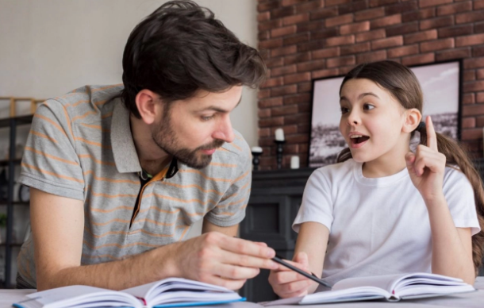

What Is PSHE?
PSHE = Personal, Social, Health, Citizenship and Education
In a very small nutshell…
It looks at the people who care for us, families and what they might look like, friendships (both face to face and digital), respecting others, keeping ourselves safe in the world, digitally and online. It talks about growing up, learning, money and the world of work.
PSHE looks at how we help each other and how we can support the community. It looks at communication, who we talk to and what we share with others and how spending time with friends and family is important.
PSHE talks about emotions like anxiety and happiness, dealing with loss, puberty and menstruation, healthy eating and exercise, mindfulness and relaxation, medicines and drugs and keeping ourselves safe and much more…

Slide 5



What Do Schools Have To Teach?
Relationships Education Health Education
Sex Education is not compulsory BUT puberty, naming external body parts, human development from birth to old age and reproduction in animals must be taught to all pupils because it is part of the Science National Curriculum in primary schools. We teach the correct terminolgy for private areas vagina, vulva, pensis and breasts from EYFS for safeguarding reasons. We use the NSPCC pants rule to discuss private areas in an age appropriate way.
We teach RSE because it supports ‘pupils’ ongoing emotional and physical development’ as they transition to secondary school. An effective RSE policy should prepare boys and girls for the ‘changes that adolescence brings’. We begin our puberty lessons at the end of year 4 with a period talks for girls. This is because some of our children begin puberty in year 4. You will recieve information about these lessons to disucss with your child at home.

Slide 6

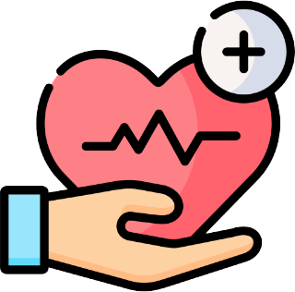

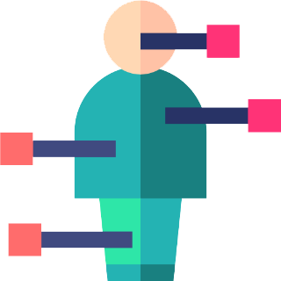


What Are My Choices As a Parent?
What must be taught?
Parents’ choice?
Relationships Education
Health Education
Puberty Education
Names of external body parts
Human development from birth to old age
Reproduction in animals and plants
You have the right to know what our school policy is on RSE
You have the right to know what will be covered in RSE by our school
You have the right to see the resources used by our school to teach RSE
You have the right to withdraw your child from the year 6 sex education lesson.
Puberty lessons in year 4 and 5 are part of the statutory guidance so don’t need permission. We will share the sliodes with you to
Discuss with your child at home.

Slide 7
What Do We Do At Our School?
We believe that teaching RSE informs our pupils about body differences, growing up, body changes and the emotions and feelings that they might have. Specific vocabulary that they learn allows them to keep their bodies safe and empowers them to communicate any concerns that they might have about their own health or safety. It prepares pupils for their transition to secondary school and life’s journey.
We use the Lifewise, Police Education and resources and other resources for our PSHE and RSE. https://www.burradoncommunityprimaryschool.co.uk/attachments/download.asp?file=1748&type=pdf
Pupils from EYFS to Year 6 are taught age appropriate information using specific and relevant vocabulary.As parents you will be informed of the puberty talks at the end of year 4 (for girls), 5 and year 6 and given information about the lessons so that you can discuss this with your child.
The teaching often links to the Science National Curriculum and other curriculum subjects and topics
We keep parents fully informed about when RSE will be taught in each year group and what will be covered. We have a parents consent form for the lessons around conception, birth and grooming in year 6 which will detail resources used. You will be sent the lesson to discuss with your child after it has taught in class

Slide 8

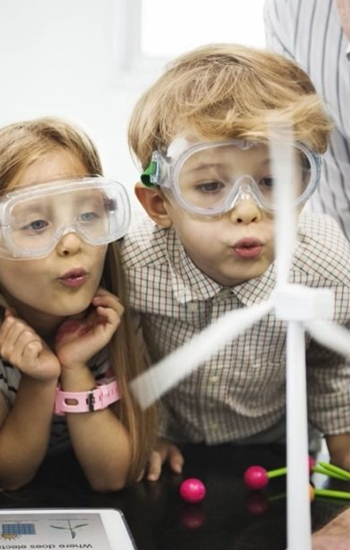
Our PSHE Timetable and Learning Intentions For reception, Key Stages 1 And 2
Our PSHE timetable covers Reception through to Year 6
Usually, your child will have one lesson of PSHE each week plus extra wellbeing activities.
We also use Thrive Whole class plans to support emeotional regulation and behaviour.
We promote the diversity of our school community by celebrating different families through stories.
Our visions and values are core to our curriulum and we explore these in House Days, assemblies and in class.

Slide 9
penis | scrotum | testicles | anus
vulva | nipples | vagina | breasts
We have used vagina and penis from reception for safeguarding reasons.
Research shows that children who know the correct names from a young age are more likely to report abuse. Adults have misunderstood children trying to report abuse in the past as they have used names for their private parts that were not recognised.
This is the new vocabulary that has been suggested.
Vulva is the scientific name.

Slide 10

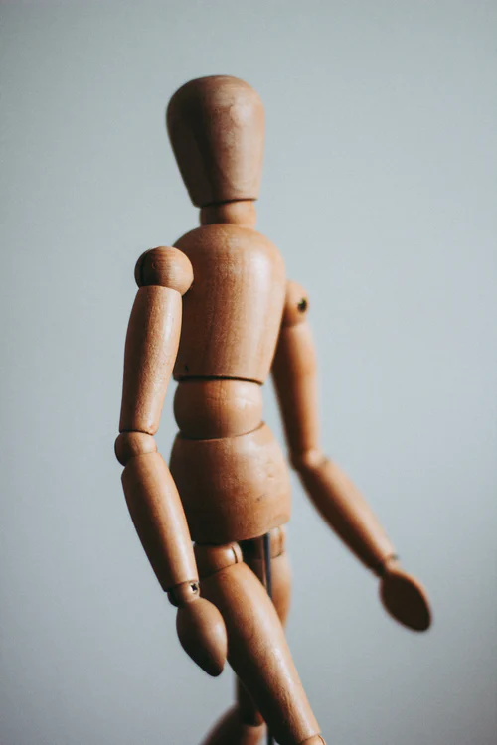
RSE In Key Reception
Naming, labelling and drawing main body parts eg: neck, head, legs, arms, elbows, face, ears, eyes, mouth, teeth, hair, nose.
It talks about looking after our body and how parents, carers or people we trust may help us keep clean by helping us to wash or bathe
It talks about saying ‘no’ if we don’t want our bodies to be touched and who to talk to if we feel uncomfortable or unhappy about our body being touched – NSPCC underpant rule.
Using the words vagina/vulva and penis as the correct terminolgy for our private areas. This is essential for safeguarding purposes.
It looks at trusted adults and who to go to for support.

Slide 11
RSE In Year 1
Y1 – My Growing Body
Naming, labelling and drawing main body parts eg: neck, head, legs, arms, elbows, face, ears, eyes, mouth, teeth, hair, nose.
It talks about saying ‘no’ if we don’t want our bodies to be touched and who to talk to if we feel uncomfortable or unhappy about our body being touched – NSPCC rules and assemblies.
It talks about who to talk to if we are worried about our health
It talks about respecting ourselves and respecting others
It talks about having the same scientific names for other body parts to avoid confusion (family names or different names and terms used for private parts are acknowledged but are not specifically named to avoid pupils becoming confused)
This lesson introduces the scientific body parts of the anus, nipples, vagina, vulva penis and testicles.

Slide 12
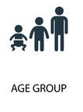
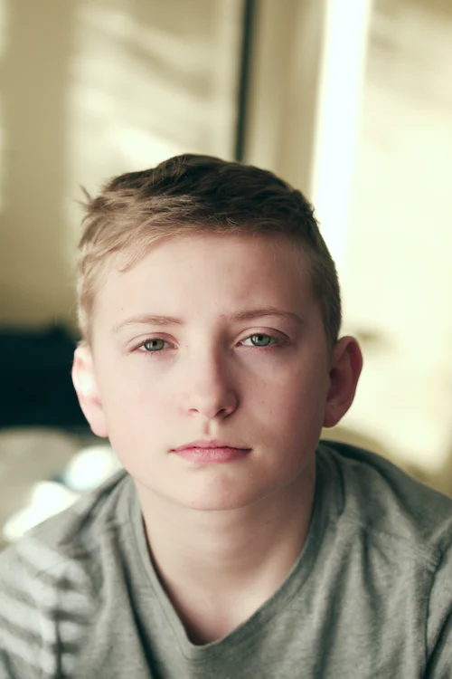
RSE In Year 2
Y2 – My Private body
Naming, labelling and drawing main body parts eg: neck, head, legs, arms, elbows, face,
Recognising that parts of the body are private – penis, vagina, vulva, testicles, anus.
what to do if you feel uncomfortable about these parts being touched.
Know trusted adults you could go to for help. Know other places of support such as NSPCC

Slide 13
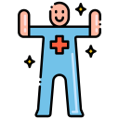


RSE In Year 3
Y3 – My Body, Your Body keeping healthy, different friendships and gender sterotypes
This lesson discusses how we can keep our bodies healthy in a variety of ways such as needing the right types and amount of nutrition.
Talks about the human skeleton and its functions in terms of movement, support and protection. It talks about the names and locations of major organs inside the human body.
Discover the values of different types of friendship and as they experience an even wider range of relationships, they will establish the differences in qualities and behaviours that they should expect and exhibit within them.
Developing friendships based in respect, kindness, trust and honesty. They are encouraged to think about the boundaries of different friendships in preparation to explore how friendships can change from platonic to romantic
Encourage children to respect the different ways that people think of themselves and for them to be confident that the way they describe themselves to others is a matter for their personal choice and that uniqueness should be respected
● Know that, sometimes unconscious expectations about gender can lead us to treat people badly.

Slide 14

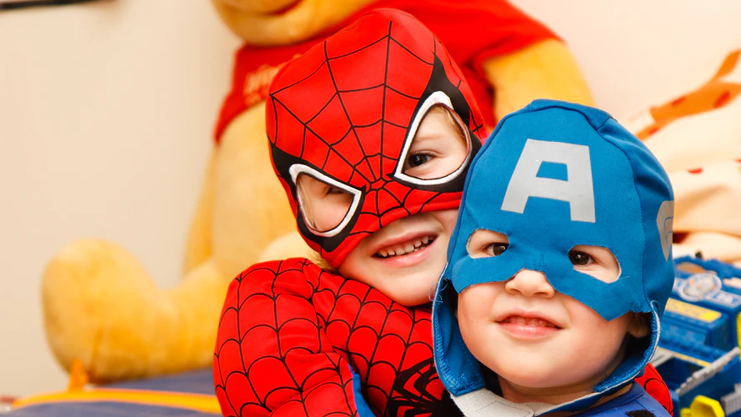
RSE In Year 4
RSE In Key Stage Two
Y4 – My Body, Your Body – keeping safe (end of year 4)
Girls will also have a separate period talk with class teacher
What Do We Do At Our School? This lesson talks about how to recognise who to trust and who not to trust, how to judge when a friendship is making them feel unhappy or uncomfortable, managing conflict, how to manage these situations and how to seek help or advice from others, if needed
It talks about what sorts of boundaries are appropriate in friendships with peers and others (including in a digital context) amd how to report feeling unsafe
It talks about the concept of privacy and the implications of it for both children and adults; including that it is not always right to keep secrets if they relate to being safe
It talks about that each person’s body belongs to them, and the difference between appropriate and inappropriate or unsafe physical, and other, contact and how to report concerns

Slide 15
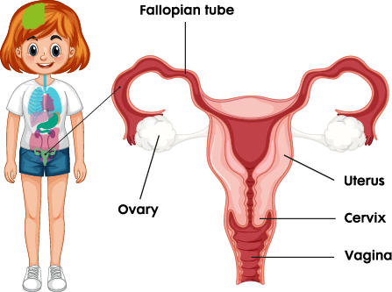
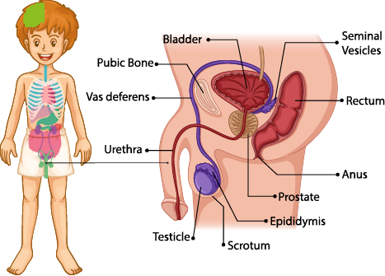
.
School powerpoint (powerpoint shared with parents) and operiation ouch video
https://www.bbc.co.uk/iplayer/episode/b0759l4k/operation-ouch-specials-dont-panic-about-puberty
It consolidates understanding of the names and locations of the male and female genitals
It discusses how body parts grow or change to accommodate the growth or feeding of offspring
This It talks about changes in a woman’s and mans body both inside and out as they gets older and why they occur
It talks about the effect of puberty on mind and body
It talks about the menstrual cycle and why and how this occurs. The girls in year5 will also have a period discussion with class teacher and look at products etc.
It discusses wet dreams with boys and why these can happen
RSE In Year 5 – puberty and changes in the body

Slide 16
School powerpoint andHelp kids learn how babies are made [with Foxy] - YouTube
(powerpoint shared with parents on seesaw and consent letter)
Using the terminology for the genitals/private parts and looking at these on a diagram and discuss what happens during puberty
The lesson discusses mood swings, emotions, embarrassment and feelings of insecurity and that these are normal feelings around the time of puberty
This lesson discusses how sometimes sperm is sometimes released from the penis and that this is commonly known as a ‘wet dream’
This lesson discusses sperm production and fertilisation of the female egg cell
The lesson discusses the human life cycle and the considerations to be made before creating an embryo (year 6 – parental permission)
To understand concent and how to stay safe from grooming and what grooming can look lie
To know the signs of a healthy relationship and spot any signs that would mean a relationship is not safe – ready for transition to High School.
RSE In Year 6 – puberty and conception

Slide 17
Frequently Asked Questions
Will my child learn about same sex marriage or partnerships?
Yes. Your child is growing up in a modern, diverse society and they will see different relationships around them. We talk with them about relationships and families and how they may look different to their own. We focus on what makes families, partnerships and relationships special, important and secure and emphasise that love, care, trust and respect is the key to any happy relationship.
Why does my child need to know the names of private body parts?
By using the scientific names for body parts from an early age, pupils become more familiar with using these, are more likely to use them correctly and it avoids confusion with family ‘pet’ names for parts of the body. Children are then more able to identify and talk about their health and safety more accurately too. It supports safegarding in school.
What do I do if I want to discuss what is being taught in Sex Education?
Talk to your child’s class teacher, the PSHE subject leader in the school or the Head Teacher if you have questions that you wish to ask.
Where can I find the school’s policy on PSHE and Sex Education?
You can find this on our school website or ask at the school office for a hard copy. The policy is reviewed and updated regularly and feedback from pupils, parents, staff and governors is used to shape this.

Slide 18
Frequently Asked Questions
Will my child learn about FGM?
We have decided as a school to not teach about FGM at this time.This will be under review and we will notify parents if
this changes.
Will boys and girls be taught separately about Sex Education?
In year 5 boys and girls will learn about pubery together including menstruation. The girls will then be given a discusssion time with the class teacher to go over the topic in more detail, look at products etc. Boys will be given a separate lesson around wet dreams in year 5. In year 6 all lessons are planned to include both boys and girls and the information around menstruation and wet dreams will be shared with the whole class. This decision was taken through pupil voice activities.
Will I be informed what my child will be learning?
Yes. We will send a letter detailing what your child will be learning during the puberty lesson and send out informatin so you
can talk to your child at home. In year 6 when children learn about conception and birth you will be given a parental
consent letter to sign and return to school.

