Slide 1
Teachers Guide…
This PowerPoint will help children understand how to double an object. This game can be used within your whole class teaching or as an independent game on your interactive whiteboard.
The children can select the number which they think is the right answer. If they select the incorrect answer it will take them back to the question to allow them to find out the correct answer.
Best thing is to have a play yourself.
I hope this is useful! Have fun!!! ☺

Slide 2

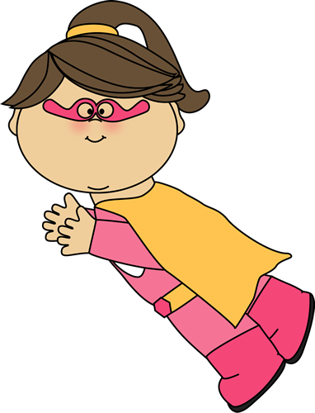

The Doubling Machine
double
Hi! We are Sam and Sally the superheroes! It is our job to help save the world.
Here is our doubling machine. We use this to save the world.

Slide 3
Help us double the objects and find the correct answer to save the world…
The Doubling Machine
double

Slide 4
The Doubling Machine
double

Slide 5

The Doubling Machine
double
If 1 apple goes into the machine, how many will come out?
2
4
3

Slide 6
The Doubling Machine
double
Next mission!!!
Well done…
Press the double button!

Slide 7
Oops!!! Have another try!!!!

Slide 8
Oops!!! Have another try!!!!

Slide 9
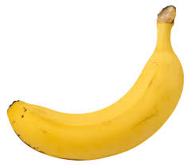
The Doubling Machine
double
If 3 bananas go into the machine,
how many will come out?
2
6
4

Slide 10
The Doubling Machine
double
Next mission!!!
Well done…
Press the double button!

Slide 11
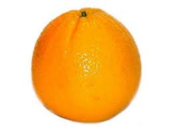
The Doubling Machine
double
If 5 oranges go into the machine,
how many will come out?
6
12
10

Slide 12
Oops!!! Have another try!!!!

Slide 13
The Doubling Machine
double
Next mission!!!
Well done…
Press the double button!

Slide 14
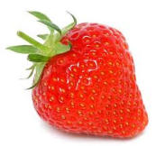
The Doubling Machine
double
If 8 strawberries go into the machine,
how many will come out?
16
19
18

Slide 15

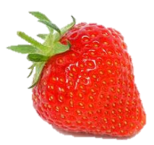
The Doubling Machine
double
Back to base!!!
Well done…
Press the double button!

Slide 16
Oops!!! Have another try!!!!

Slide 17

Thanks for helping us save the world!!!
MISSION OVER!!!!
Until the next time….

