Slide 1
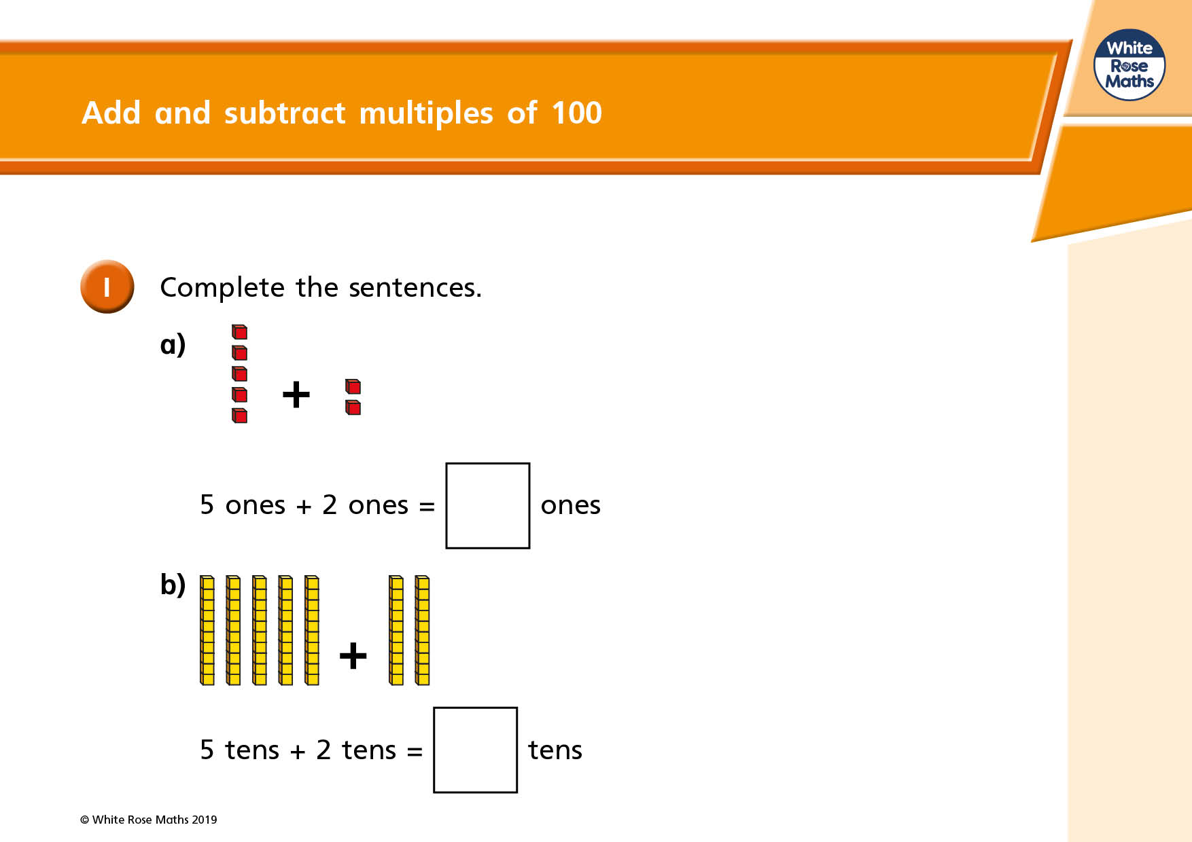

Slide 2
Complete these sentences:
+
6 ones plus 2 ones =
+
6 tens plus 2 tens =
Notice how the answer for 6 tens plus 2 tens is ten times bigger than 6 ones plus 2 ones.
The answer for 6 hundreds plus 2 hundreds is ten times bigger than 6 tens plus 2 tens. It is one hundred times bigger than 6 + 2.
6 + 2 = 8
60 + 20 = 80
600 + 200 = 800
Or you could say 6 ones plus 2 ones is ten times smaller than 6 tens plus 2 tens.
6 tens plus 2 tens is ten times smaller than 6 hundred plus 2 hundred.
+
6 hundred plus 2 hundred =

Slide 3
Challenge 1
Complete these:
1. 3 + 4 = 2. 5 + 6 = 3. 2 + 3 =
30 + 40 = 50 + 60 = 20 + 30 =
300 + 400 = 500 + 600 = 200 + 300 =
4. 4 – 2 = 5. 6 – 5 = 6. 7 – 3 =
40 – 20 = 60 – 50 = 70 – 30 =
400 – 200 = 600 – 500 = 700 – 300 =

Slide 4
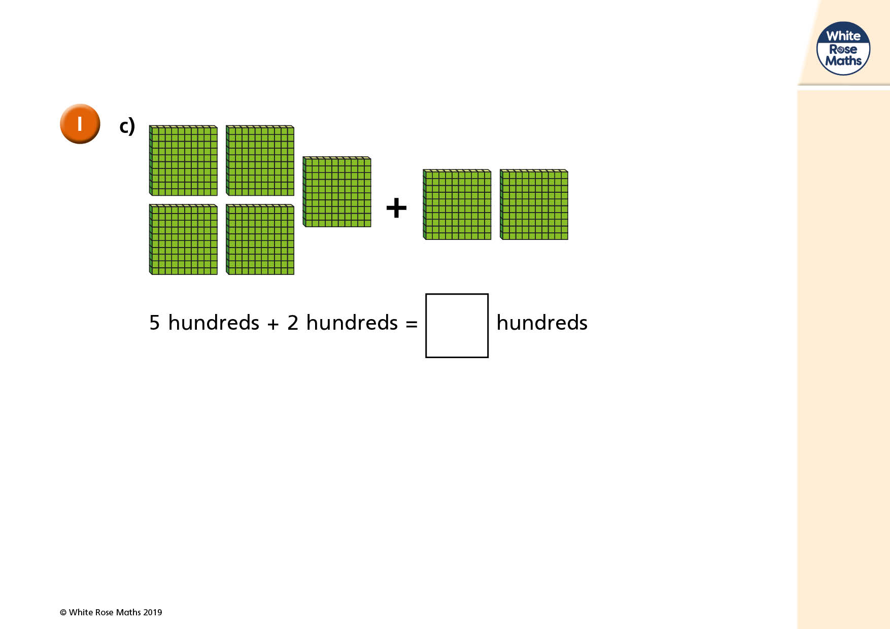

Slide 5
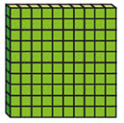
+
=
+
=
+
=

Slide 6
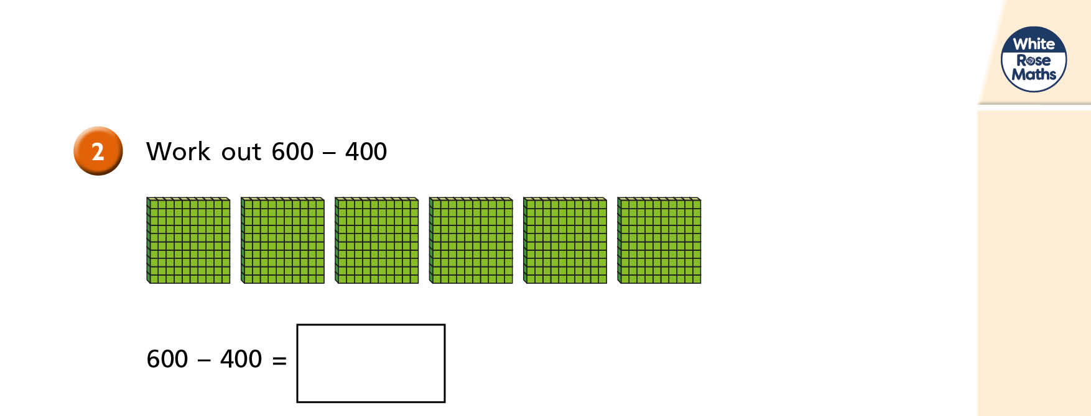
Calculate 400 minus 300
400 – 300 =

Slide 7
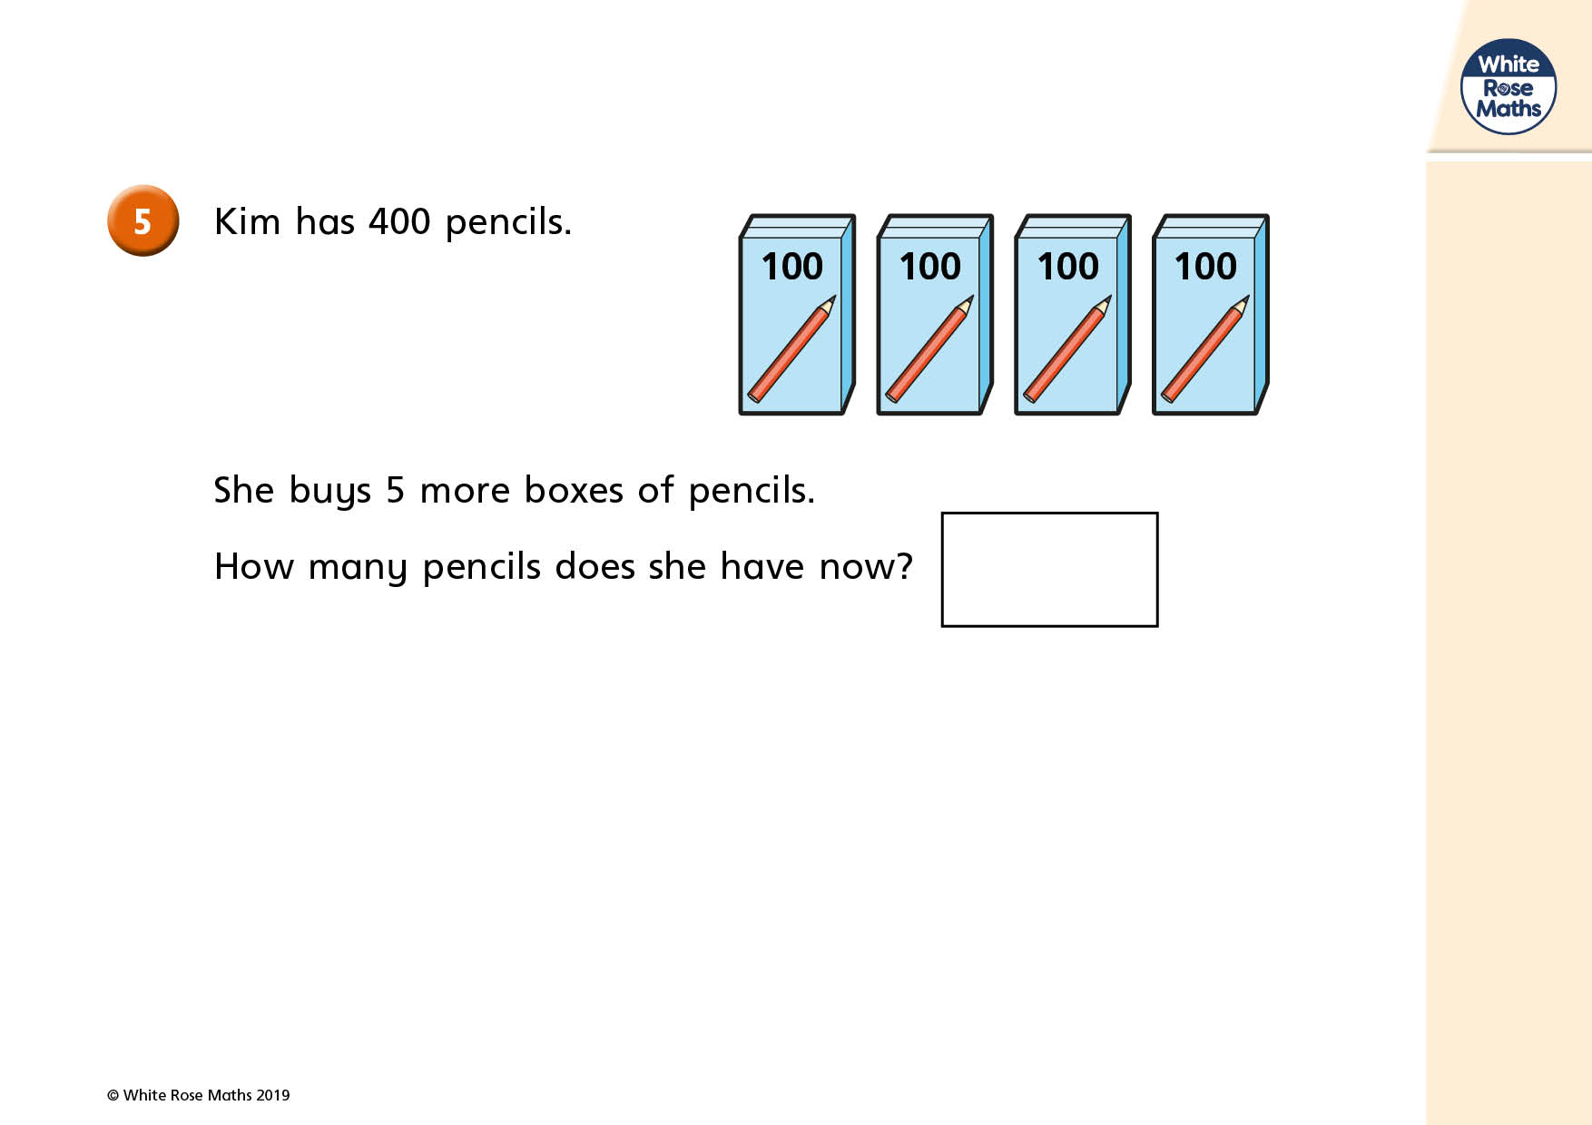
Challenge 2
Katie has 2 packs of pencils. Each pack has 100 pencils in. She adds another 2 packs of pencils. How many pencils does she have?
One pack has 100 pencils. I would like to buy another 4 packs. How many pencils will I have?
John had 6 packs of pencils. Each pack has 100 pencils in. He gives Mary 3 packs. How many pencils does he have left?

Slide 8
Challenge 3
100 + 200 = b) 300 + 200 =
c) 500 – 100 = d) 400 – 200 =
e) 600 + 200 = f) 100 – 100 =
g) 100 + 200 + 100 = h) 200 + 200 + 100 =
i) 100 + 300 + 100 = j) 400 + 200 + 100 =

