Slide 1
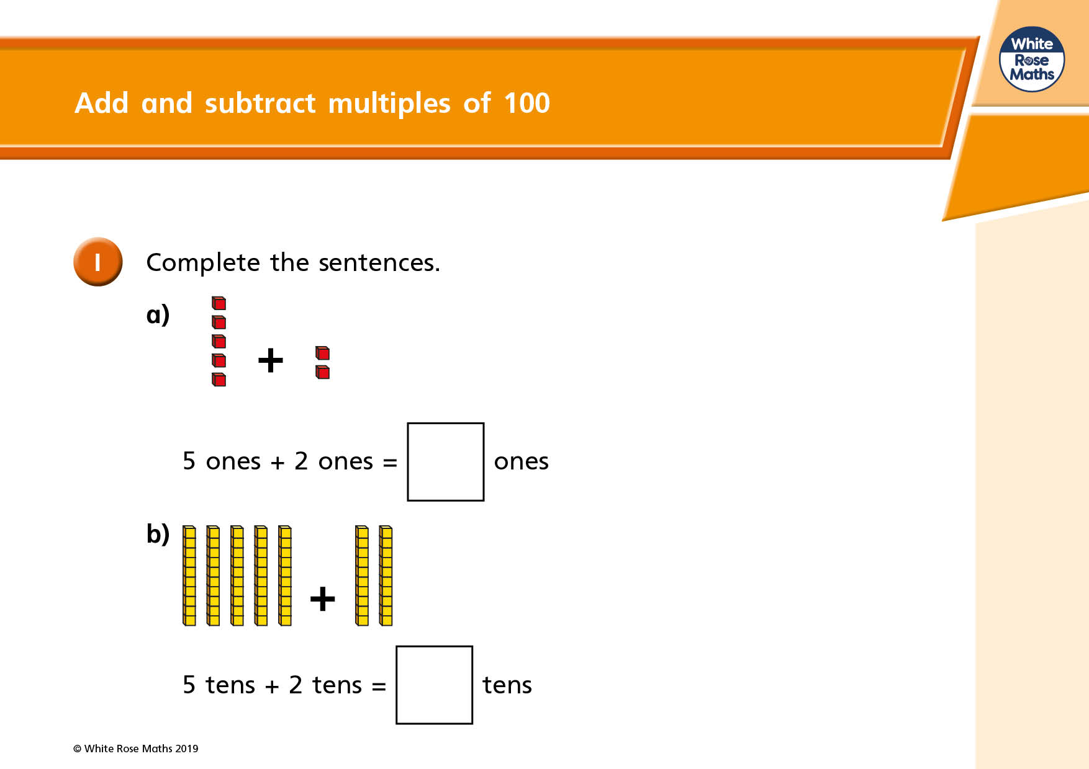

Slide 2
Complete these sentences:
+
6 ones plus 2 ones =
+
6 tens plus 2 tens =
Notice how the answer for 6 tens plus 2 tens is ten times bigger than 6 ones plus 2 ones.
The answer for 6 hundreds plus 2 hundreds is ten times bigger than 6 tens plus 2 tens. It is one hundred times bigger than 6 + 2.
6 + 2 = 8
60 + 20 = 80
600 + 200 = 800
Or you could say 6 ones plus 2 ones is ten times smaller than 6 tens plus 2 tens.
6 tens plus 2 tens is ten times smaller than 6 hundred plus 2 hundred.
+
6 hundred plus 2 hundred =

Slide 3
Challenge 1
Complete these:
1. 3 + 4 = 2. 5 + 6 = 3. 9 + 3 =
30 + 40 = 50 + 60 = 90 + 30 =
300 + 400 = 500 + 600 = 900 + 300 =
4. 4 – 2 = 5. 6 – 5 = 6. 11 – 7 =
40 – 20 = 60 – 50 = 110 – 70 =
400 – 200 = 600 – 500 = 1100 – 700 =

Slide 4
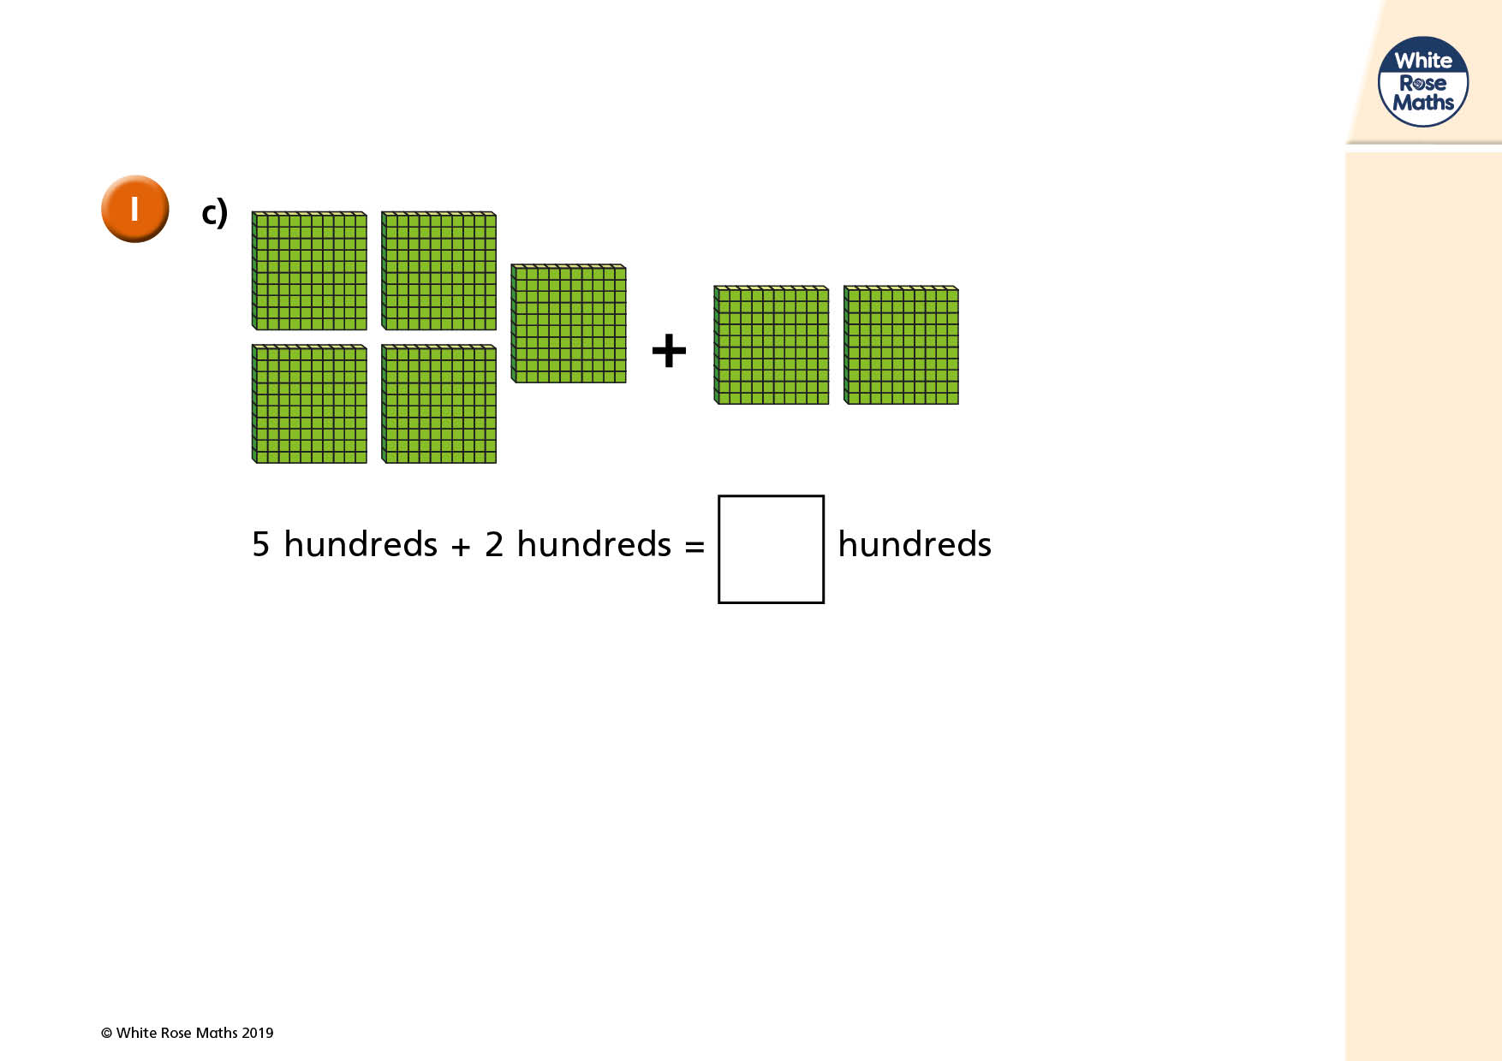

Slide 5
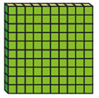
+
=
+
=
+
=

Slide 6
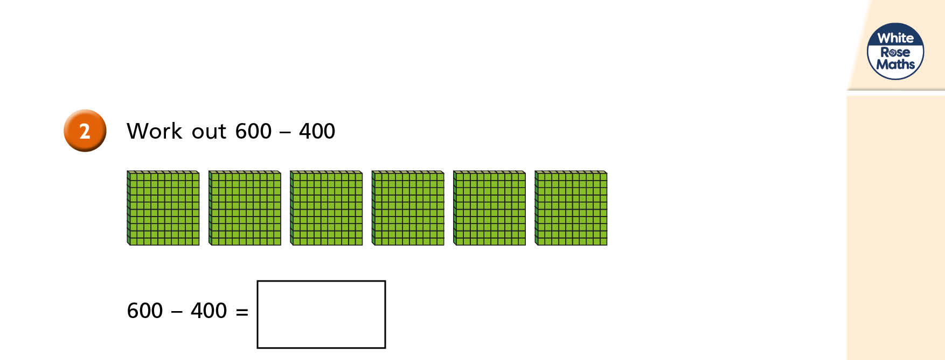
Calculate 900 minus 500
900 – 500 =

Slide 7
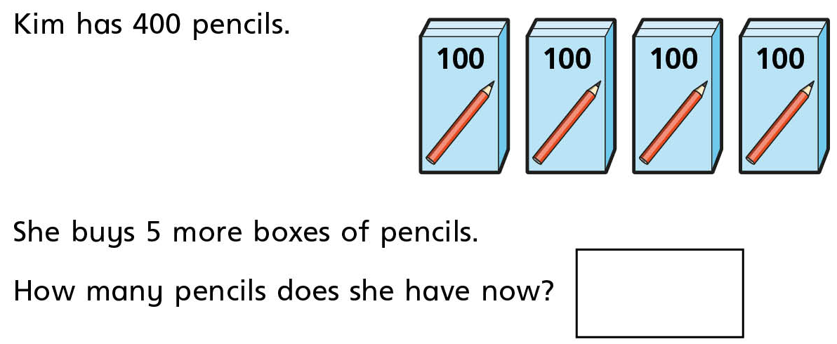
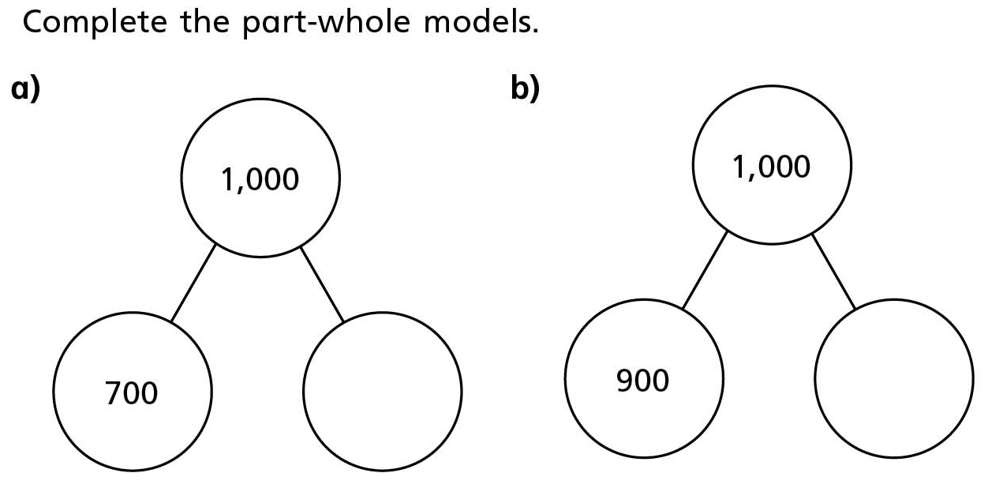
Challenge 2

Slide 8
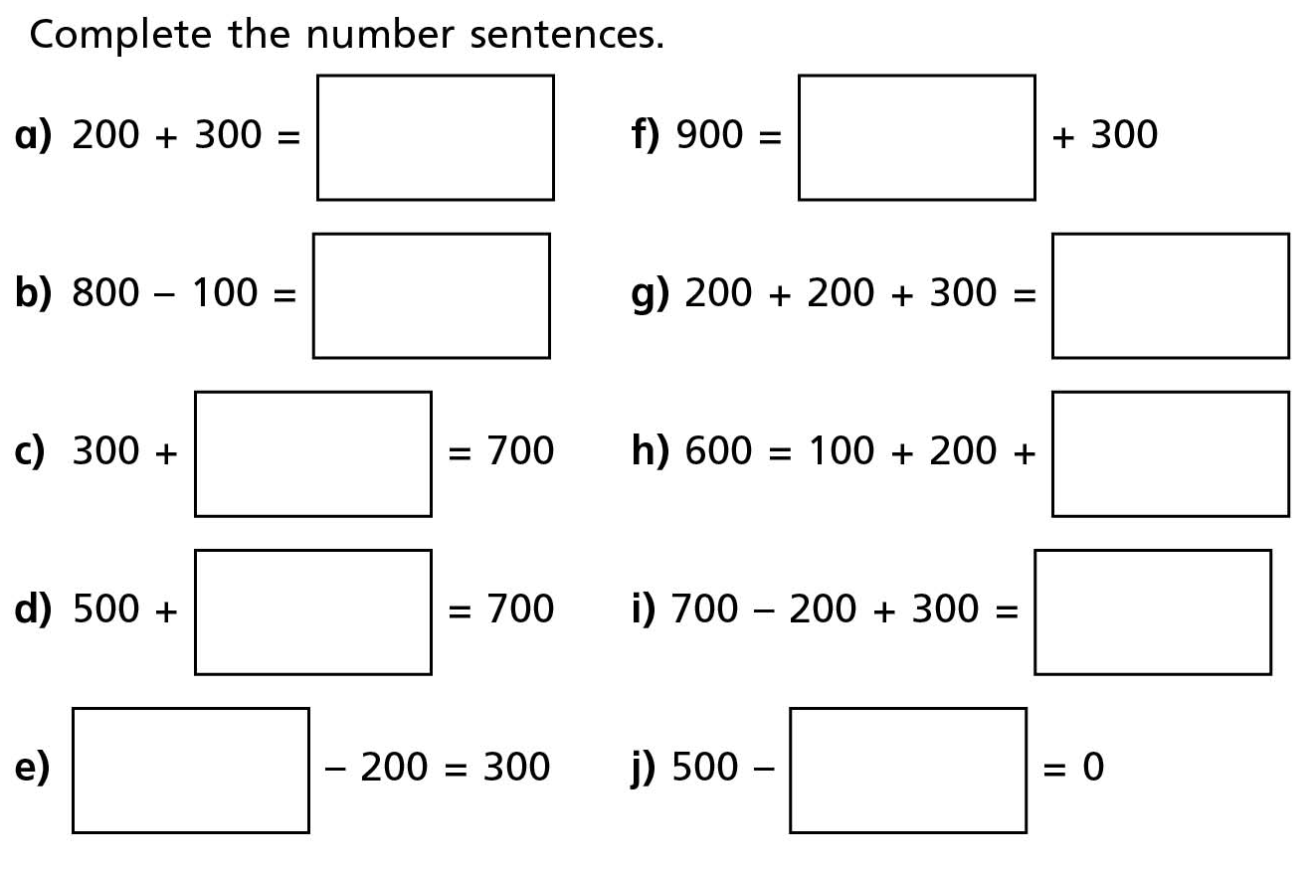
Challenge 3

